Slide 1
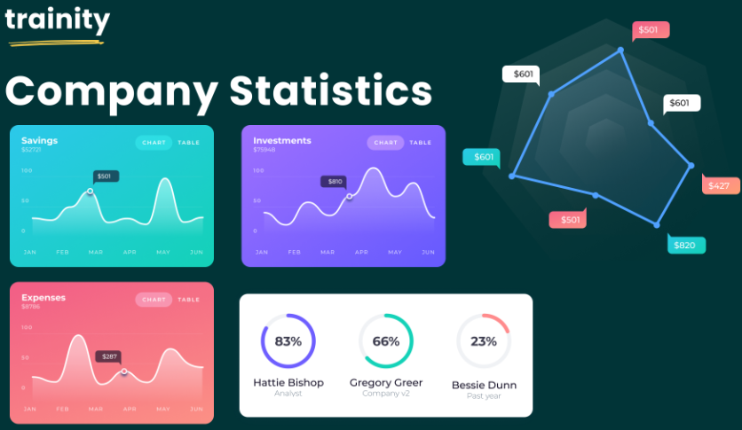
Hiring process analytics
By Drustant Metar

Slide 2
Project Description: Using a dataset supplied by the business, this research aims to investigate employment patterns of a multinational corporation (MNC). As the principal data analyst for a distinguished company such as It's your job, Google, to glean important information from the data and provide a thorough report to the hiring division. The dataset contains information about individuals who applied for a specific position in one of this company's departments.
Approach: The project employs a methodical approach to exploratory data analysis (EDA), which entails comprehending the content of the data columns, looking for missing data, grouping columns with several categories for in-depth examination, recognizing and managing outliers, and producing a data summary. With the use of statistical expertise and Excel formulas, the initiative seeks to derive significant conclusions regarding employment patterns within the organization. The hiring department will receive actionable insights from the comprehensive report, which will help with decision-making and enhance the hiring procedure as a whole.
Tech-stack used: Using Excel would be the main technology stack for this project. Excel is perfect for tasks like exploratory data analysis and extracting insights from the dataset since it provides a broad range of functions and tools for data analysis and modification. Excel's functions, pivot tables, charts, and formulae will be used to create visual representations of the recruiting data, calculate statistics, spot trends, and clean the data. This will make the analysis process easier to use.

Slide 3
4 . Insights:
Through the project, several insights were gained:
1. Job Type Distribution: The distribution of job types revealed the most frequently recruited positions within the company, aiding in resource allocation and workforce planning.
2. Interview Stage Efficiency: Analysis of interview stages highlighted potential bottlenecks or inefficiencies in the hiring process, allowing for targeted improvements to streamline the process.
3. Rejection Analysis: Understanding the reasons for candidate rejections provided valuable feedback for refining job descriptions, candidate screening criteria, and interview processes.
4. Vacancy Trends: Examining vacancy trends over time enabled forecasting of staffing needs and identification of periods with high recruitment activity.

Slide 4
5. Result
A thorough grasp of the hiring process analytics was attained during the project. Recommendations to improve the efficacy and efficiency of the hiring process at the organization were developed through the analysis of the dataset and the extraction of actionable insights. The knowledge acquired is crucial for streamlining hiring procedures, enhancing the applicant experience, and eventually boosting the business's overall success in hiring new employees.

Slide 5

Task 1:
A. Hiring Analysis: The hiring process involves bringing new individuals into the organization for various roles.
Your Task: Determine the gender distribution of hires. How many males and females have been hired by the company?
Observation: The organization employed 4085 men as opposed to 2675 women.
The company might carry out an assessment of gender diversity to guarantee fair recruiting procedures.

Slide 6
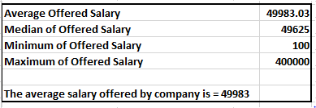
Task 2:
B. Salary Analysis: The average salary is calculated by adding up the salaries of a group of employees
and then dividing the total by the number of employees.
Your Task: What is the average salary offered by this company? Use Excel functions to calculate this.
Obervation: The organization offers an average income of Rs. 49983. The business can evaluate if this average pay is in line with rivals' and industry norms. In order to draw and keep top talent, they might need to reconsider their compensation packages if the average is noticeably lower.

Slide 7
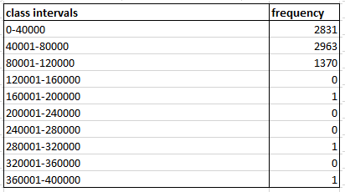
Task 3:
C. Salary Distribution: Class intervals represent ranges of values, in this case, salary ranges.
The class interval is the difference between the upper and lower limits of a class.
Your Task: Create class intervals for the salaries in the company. This will help you understand the salary distribution.

Slide 8
Observation: Most workers make between $0 and $80,000 annually. With the use of this data, the organization may examine how salaries are distributed and determine whether any changes are necessary to guarantee equitable and competitive pay, particularly for positions that are underrepresented in particular income categories.

Slide 9
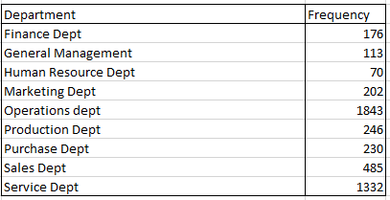
Task 4:
D. Departmental Analysis: Visualizing data through charts and plots is a crucial part of data analysis.
Your Task: Use a pie chart, bar graph, or any other suitable visualization to show the proportion of people working in different departments.

Slide 10
Observation: The departments of "Operations" and "Service" employ the majority of workers. The organization can assess the distribution of departments and think about bolstering other divisions by modifying their hiring practices or providing incentives to draw in additional talent.

Slide 11
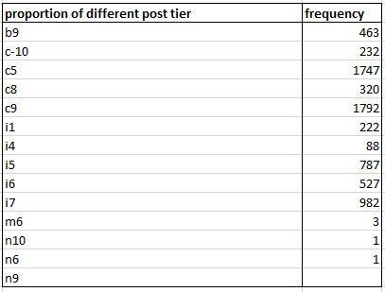
Task 5:
E. Position Tier Analysis: Different positions within a company often have different tiers or levels.
Your Task: Use a chart or graph to represent the different position tiers within the company.
This will help you understand the distribution of positions across different tiers.

Slide 12
Observation: The majority of workers are in the "c9" post tier, with "i7" and "c5" following closely behind. The data can be utilized by the organization to assess the composition of their personnel and guarantee appropriate career advancement and expansion prospects. They might also examine if the post-tier distribution fits with the company's expansion objectives.

Slide 13
6. Drive Link
Link:
https://docs.google.com/spreadsheets/d/1sZUpG_n2zmz1vLs8nVJlhvgJqDfCXSXx/edit?usp=drive_link&ouid=110876986073115360474&rtpof=true&sd=true

